Slide 1

AIRBNB in Austin Texas
Data Analyst Program - Hebrew University

Slide 2

How & What
Austin & Airbnb
Market Outlook
Spatial View & Deep Dive Analysis
Key Findings
Conclusions & Recommendations
Q&A
Agenda
Notes:
Should we remove this slide to shorten time???
High level + Austin - 5 min
Insight - 12 min
Summary & Q&A - 3 min

Slide 3

Check the potential of Austin for investment
Explore market trends
Identify target areas, property types, seasonality and population trends
Provide the details, insights and recommendations to enable informed investment decisions
The How & What
Notes:
In this slide we are going to present how we explored & and analysis of the Data

Slide 4







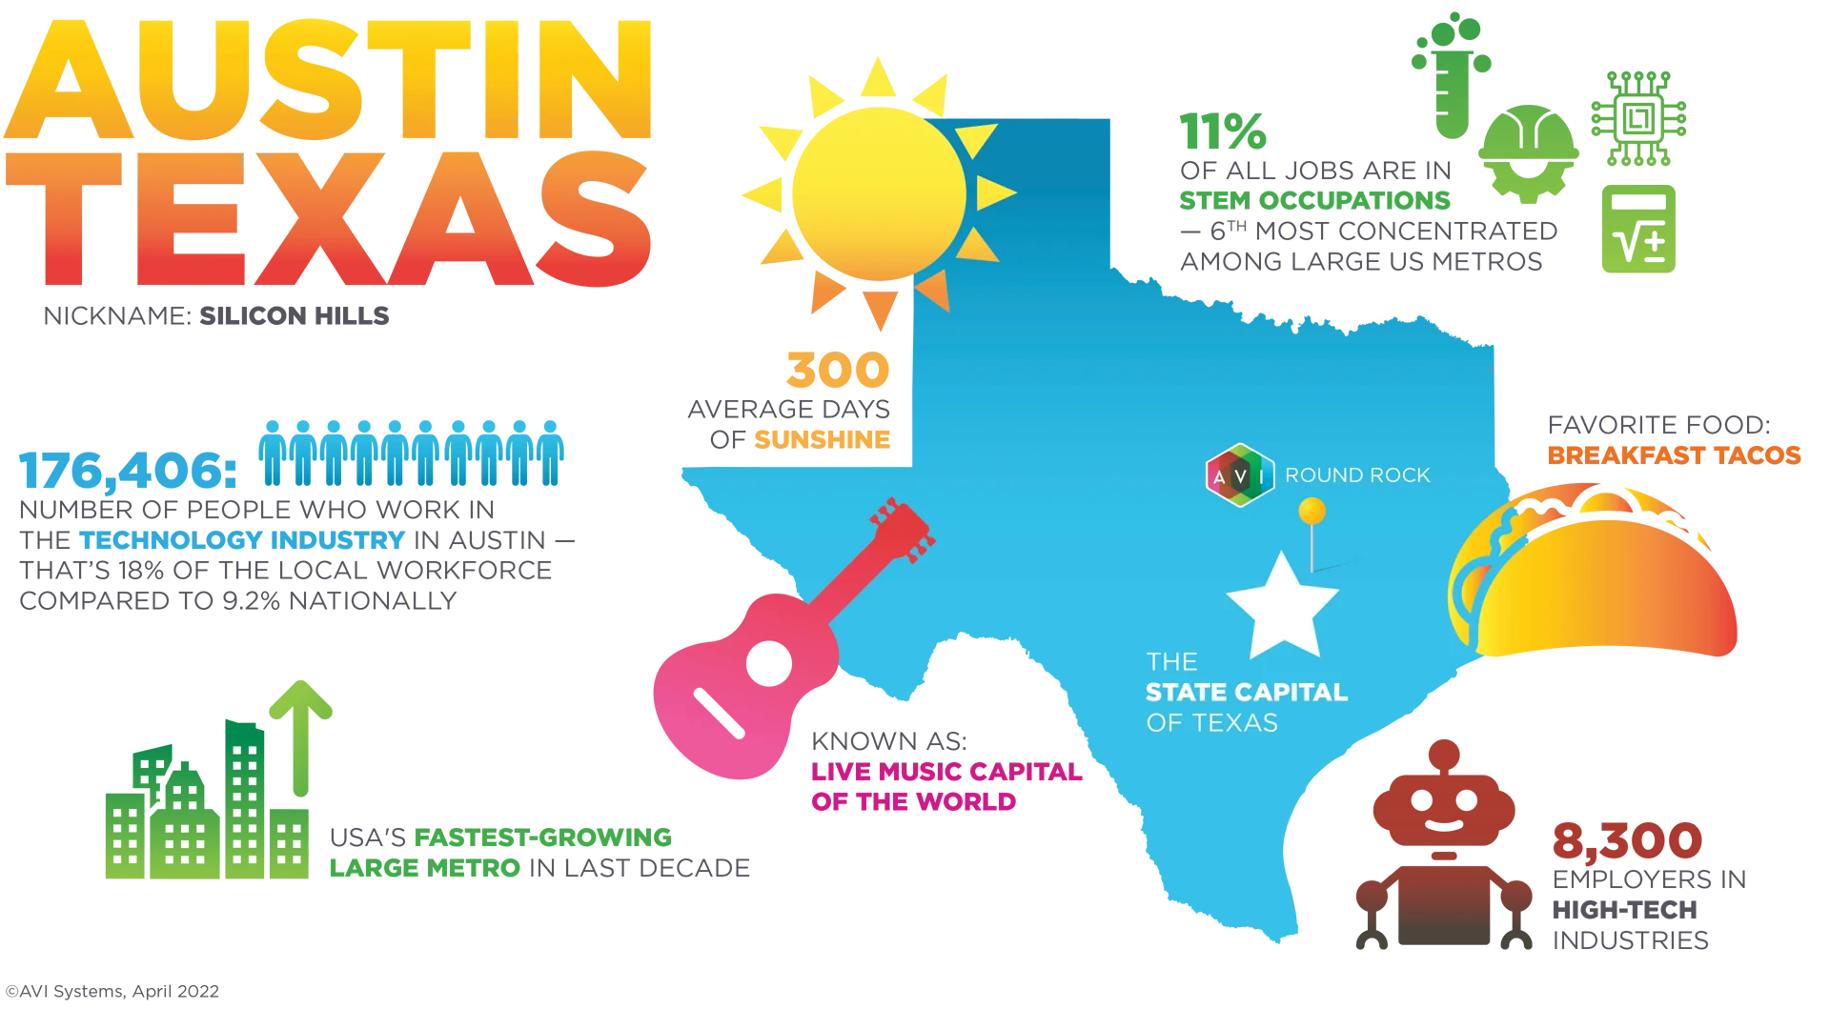


Austin is the state capital of Texas - Diverse population & ~30M Visitors Annually
Why Austin?
Growing Tech Hub of Austin
LGBTQIA+ Austin Text
Visit Austin
Notes:
Population of ~1M
Home to the University of Texas flagship campus
Known for its eclectic live-music scene centered around country, blues & rock
Its many parks and lakes are popular for hiking, biking, swimming and boating
Progressive culture, Austin's got it — it's the third-best LGBTQ city in the US
Growing investments in high-tech & increase of start-ups
Become one of the hottest relocation hotspots for tech talent during the pandemic, and favorite by San Francisco techies
Tesla founder Elon Musk has a Cybertruck factory under construction outside the city, and his Boring Company recently bought an industrial site nearby

Slide 5
Consistent revenue growth YoY
Expand for new markets & services beyond accommodations
Austin has Thriving job market, A high quality of life, Gentrification & Rising housing costs
Investors can benefit from various tax deductions & incentives per Texas state laws
Austin has variety of tourism population (Students, Friends, Families, Business)
Tourism variety & spread across the year, Require variety of properties
AirBnB's Global Success & Austin Specific
What It's Like in the Growing Tech Hub of Austin, Texas
Notes:
Tax law beneficial & incentive can significantly enhance the property's profitability and long-term value
For users - Airbnb growing as it alternative accommodation per market demand, operates in numerous countries & cities worldwide, platform is user-friendly, Enable diverse offering, Review & rating system builds trust among users, Airbnb has worked to adapt to local regulations and address concerns from cities and communities. This adaptability has allowed it to navigate regulatory challenges in various markets

Slide 6
Market Outlook

Slide 7
~10.1K of AirBnB listings in Austin with positive score > 0.05
The first rental was up in March 2008 in McKinney
Over ~546K guest reviews
The average price for listing ranges from $10 per night to $10K per night
Listings with $10K price tag are in the neighbourhoods of Windsor Park, Northeast Austin
A Quick Glance At The Data
Notes:
Analysis of Data Quality
Price : The price column contained data in string format with the currency symbol “$” and comma separator attached to it.
Date: We transformed the host_since and date columns to datetime format.
Dealing with missing values : The data also had null values to preserve all the information, we imputed or dropped the rows containing null values.
Imputed : we fixed some wrong entry in the host_neighbourhood column, moreover, we segment the property type, the zipcode and the price columns.
Exploratory Data Analysis - Hypothesis Testing, Sentiment Analysis, Spatial Data Analysis, Demand and price analysis, Textual data mining, Other interesting insights

Slide 8
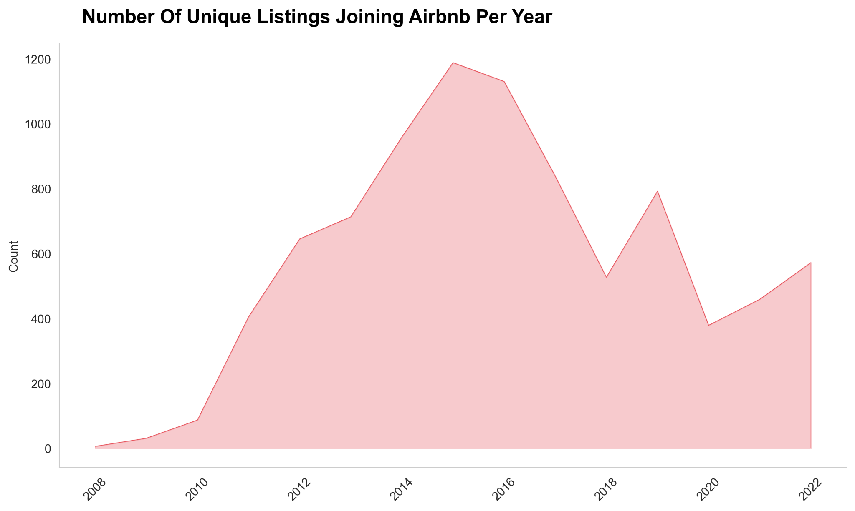
Number Of Unique Listing Entering AirBnB Market Per Year
Notes:
Why there is downsize in 2018?, 2020 is Covid
Analysis of Data Quality
Price : The price column contained data in string format with the currency symbol “$” and comma separator attached to it.
Date: We transformed the host_since and date columns to datetime format.
Dealing with missing values : The data also had null values to preserve all the information, we imputed or dropped the rows containing null values.
Imputed : we fixed some wrong entry in the host_neighbourhood column, moreover, we segment the property type, the zipcode and the price columns.
Exploratory Data Analysis - Hypothesis Testing, Sentiment Analysis, Spatial Data Analysis, Demand and price analysis, Textual data mining, Other interesting insights

Slide 9
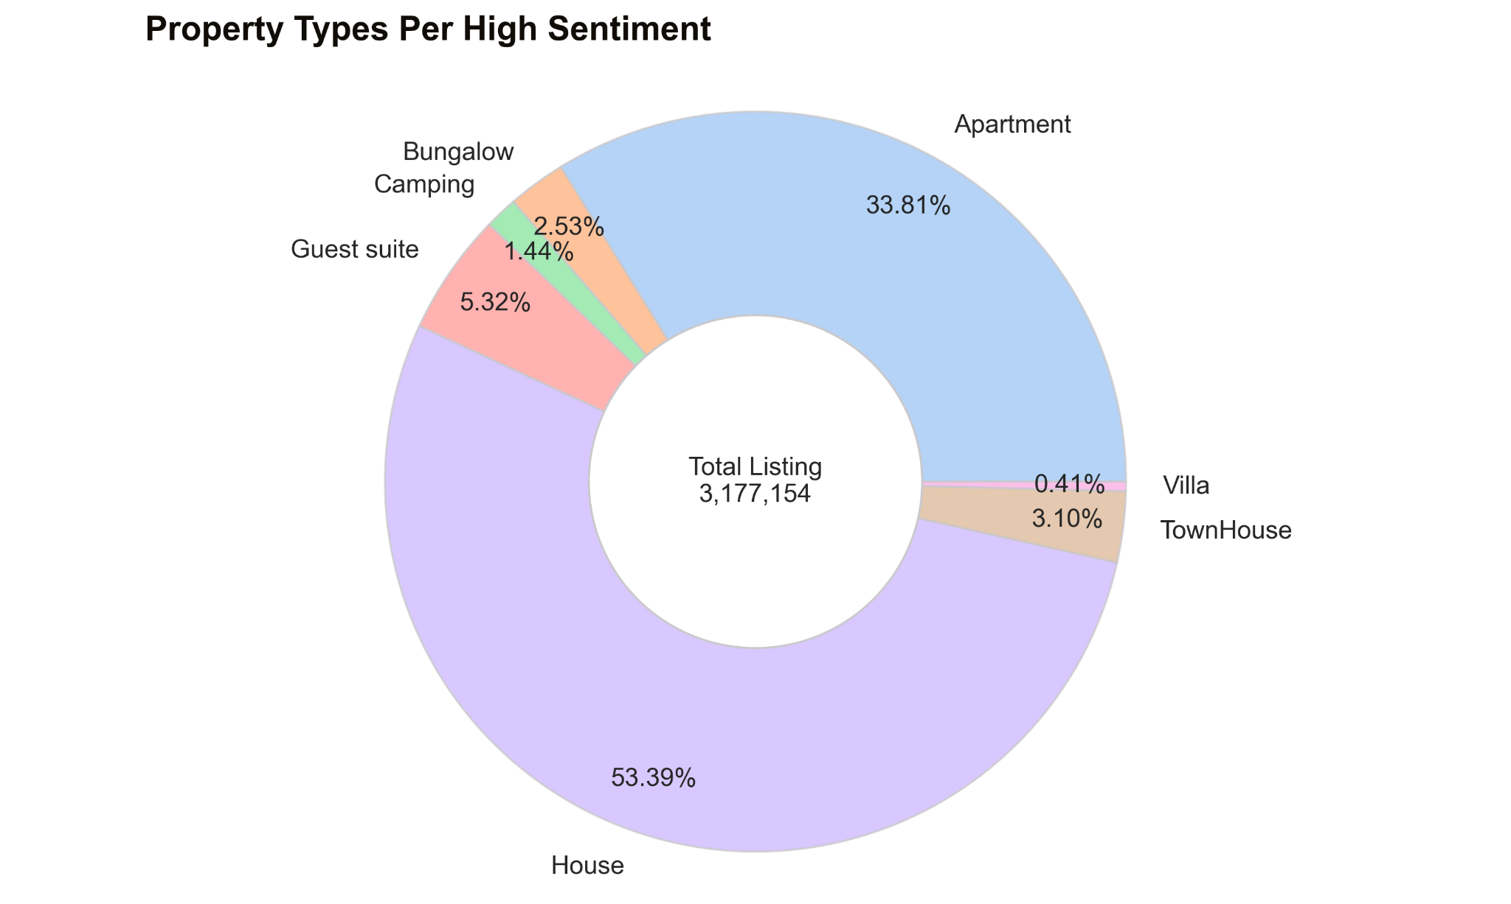
Property Types With High Sentiments

Slide 10
Spatial View & Deep Dive Analysis

Slide 11
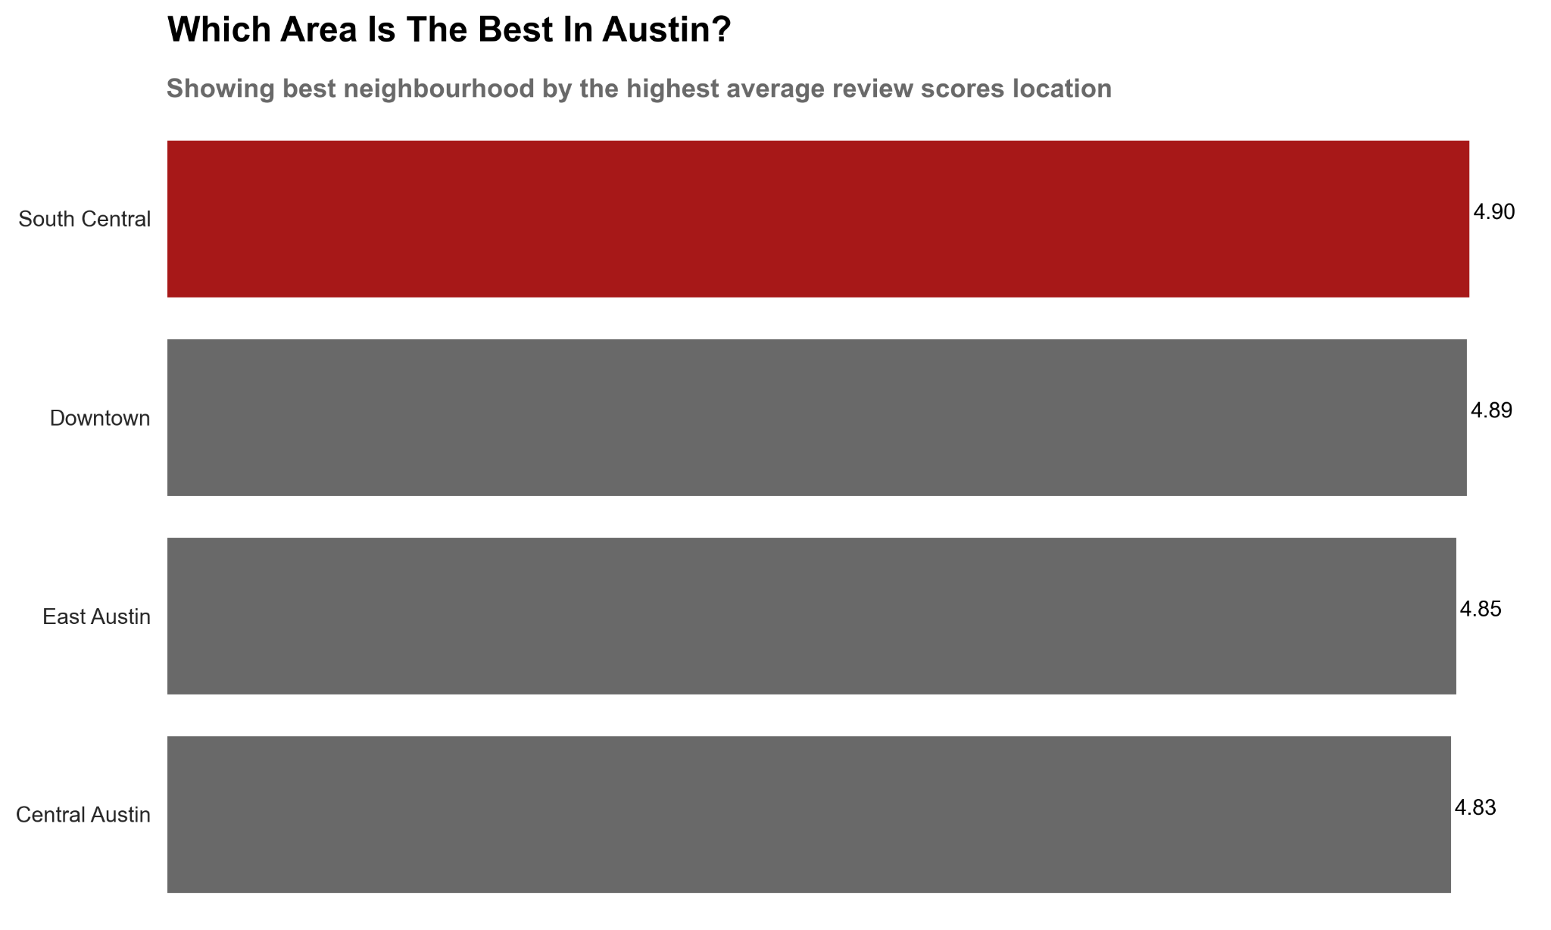
Which Area Is The Highest Rated In Austin?

Slide 12
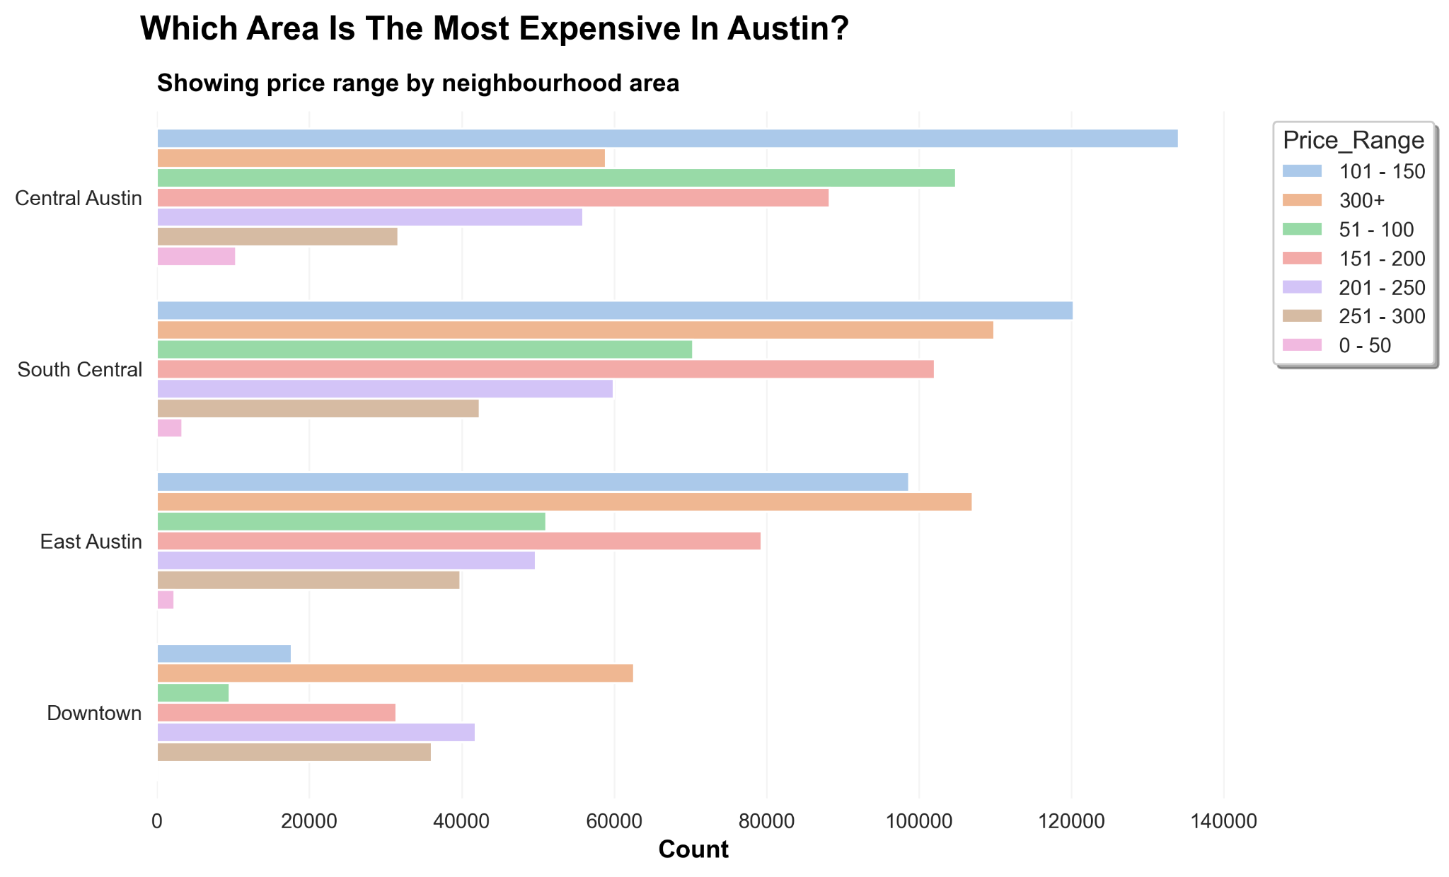
Which Area Is The Most Expensive?

Slide 13
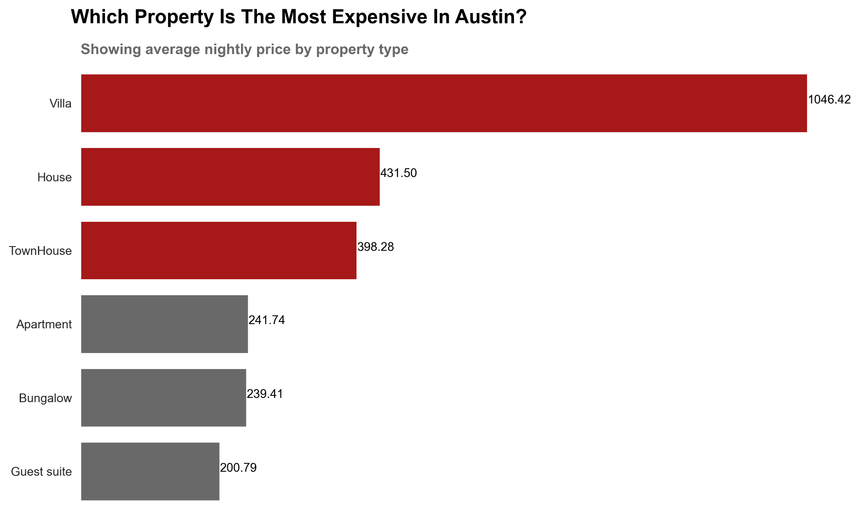

Slide 14
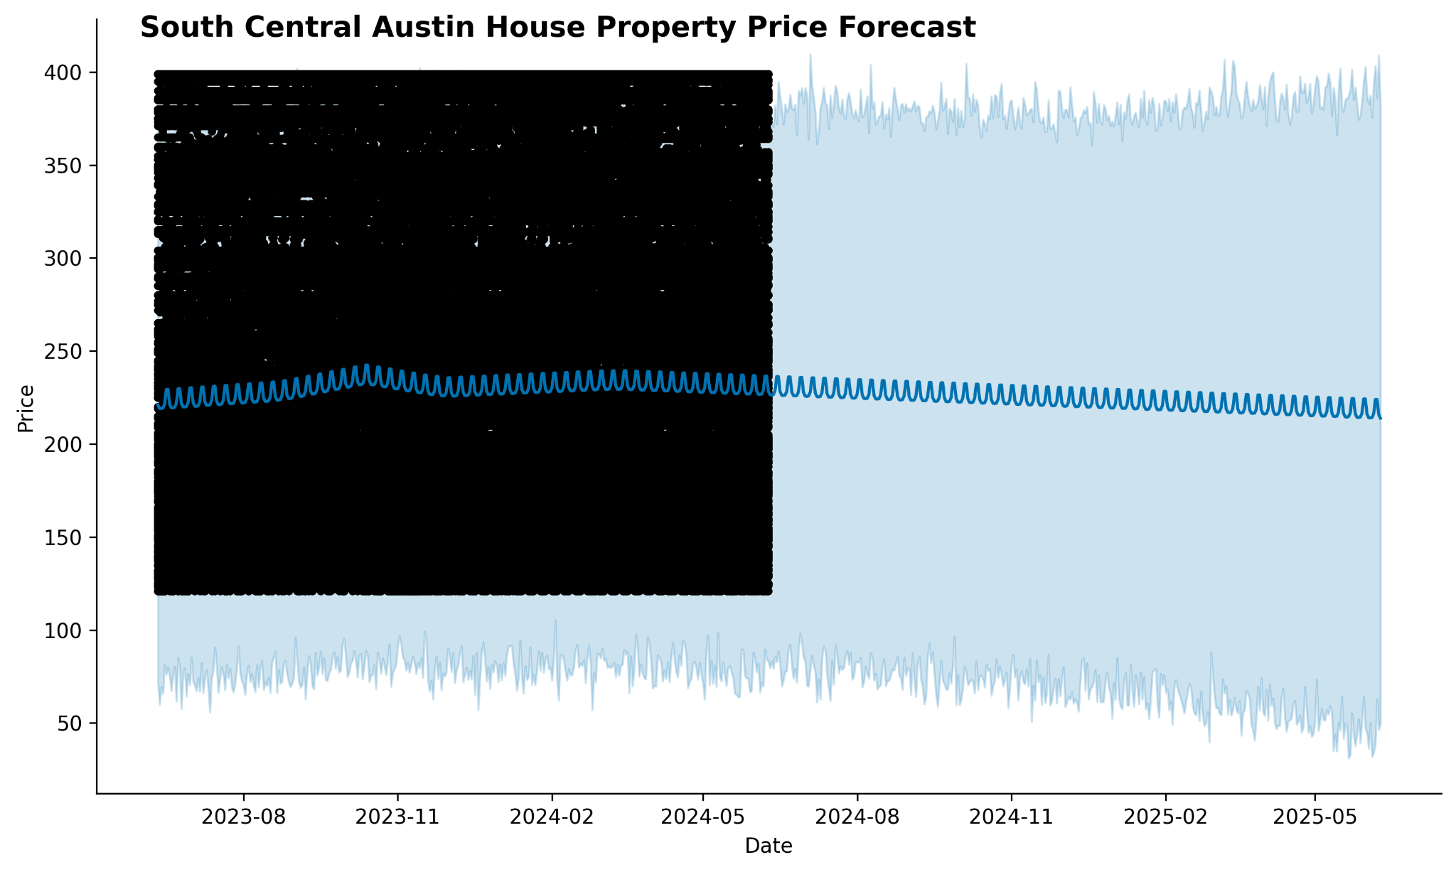
South Central Austin Price Forecast For House Property
Notes:
East Austin is the most popular neighbourhood - amount of houses + reviews

Slide 15
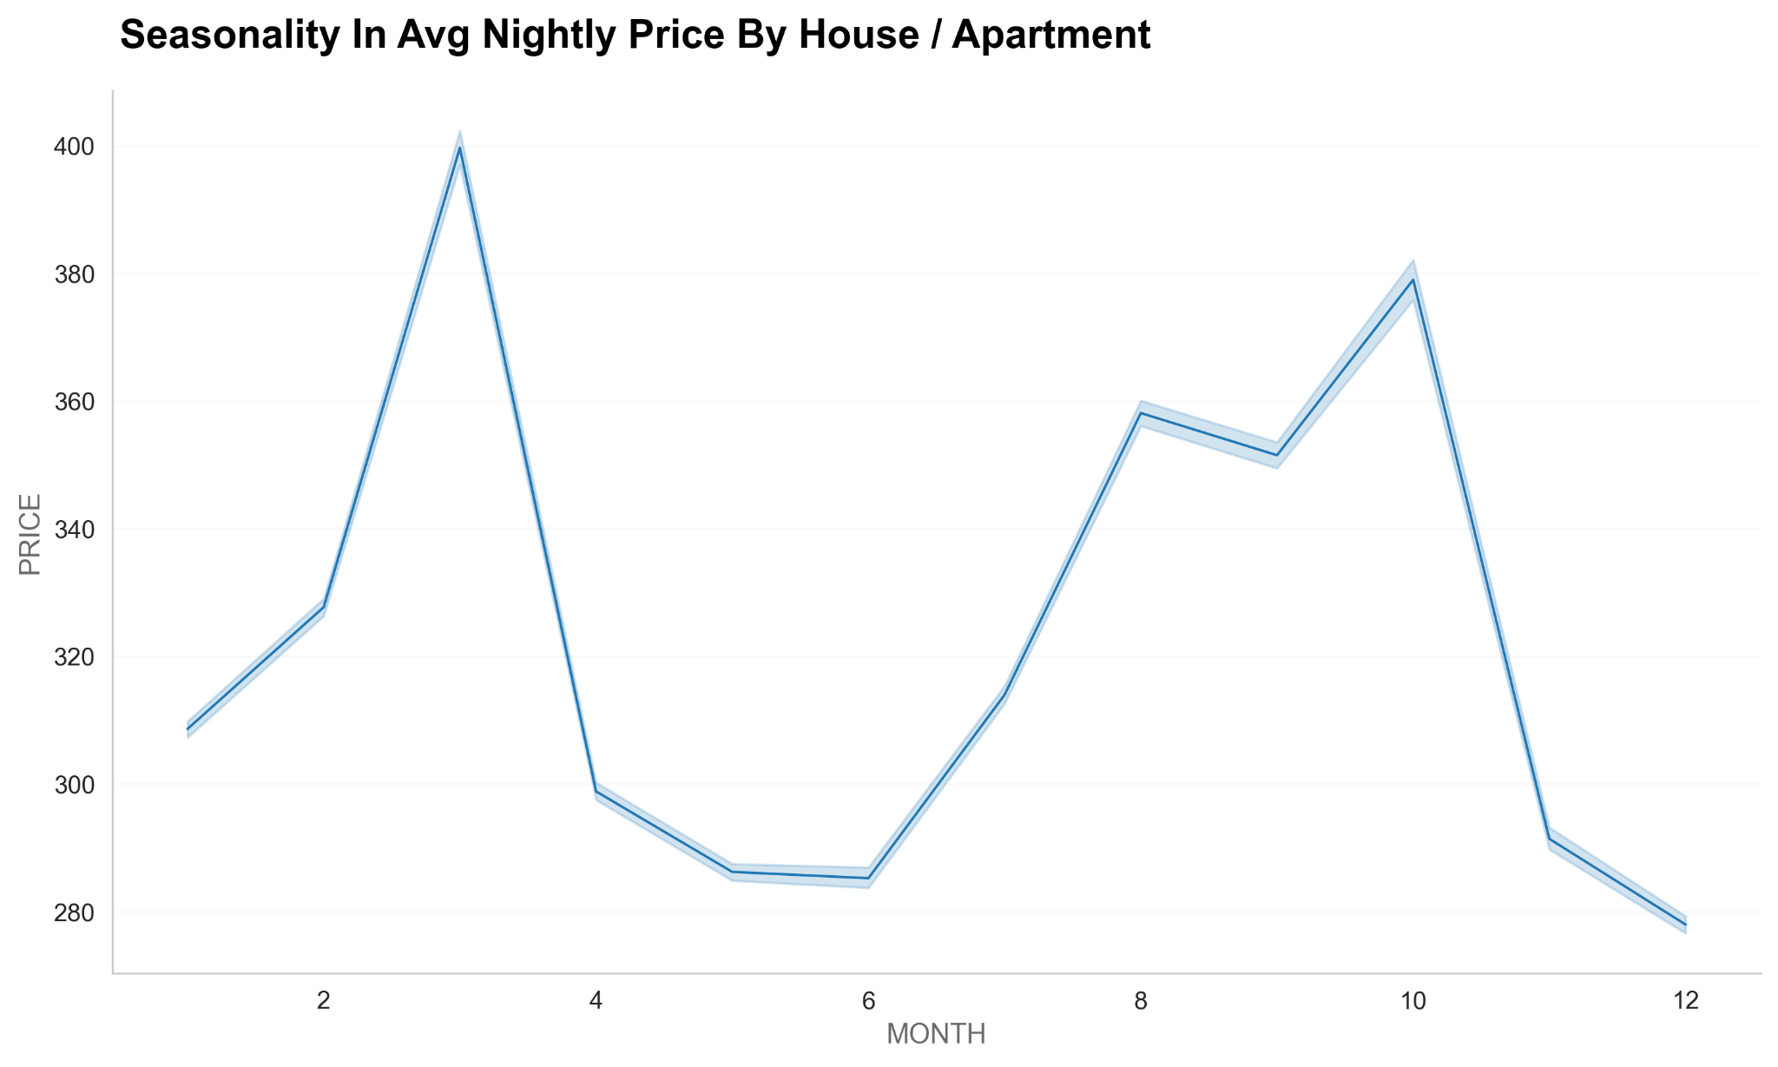
Seasonality Per Avg. Nightly Cost By Hours/Apartment
Feb April June Aug Oct Dec
iMonth

Slide 16
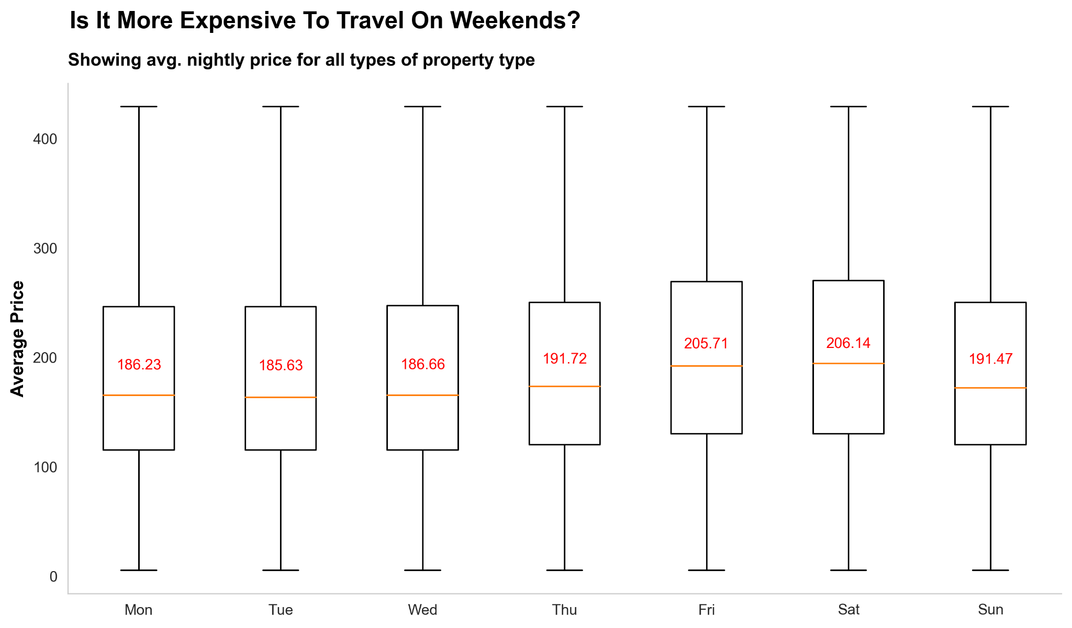

Slide 17
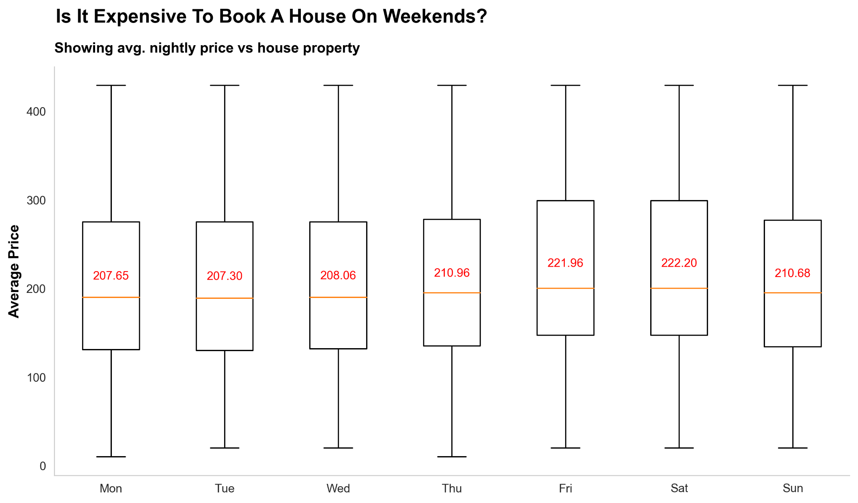

Slide 18
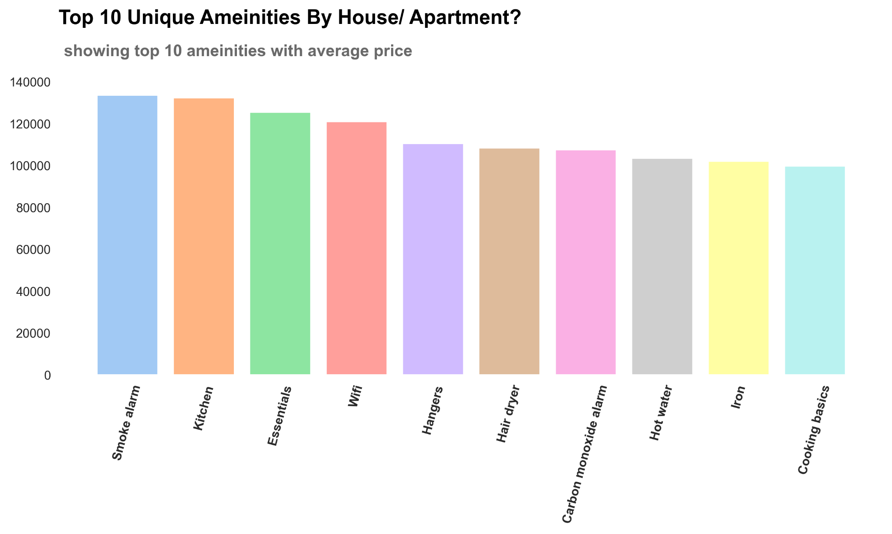

Slide 19
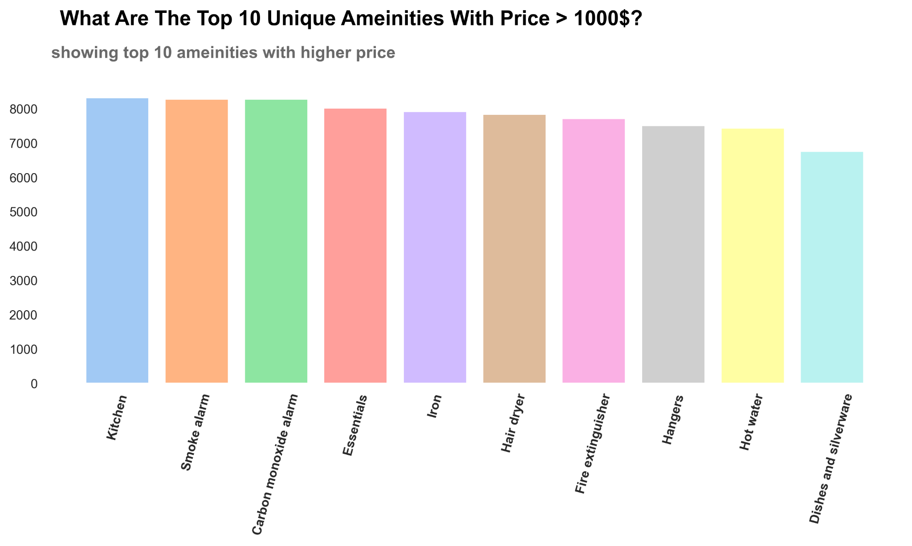

Slide 20
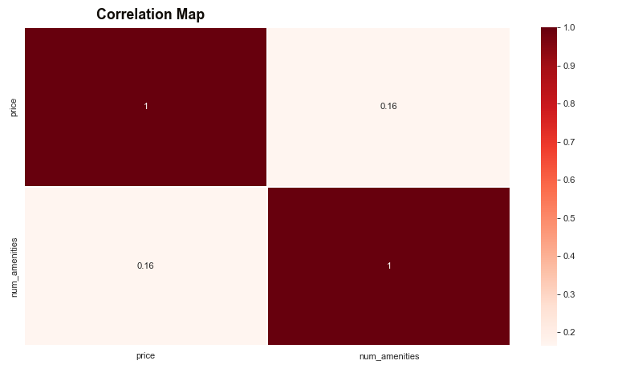
Correlation Between Price & Number of Amenities - HeatMap

Slide 21
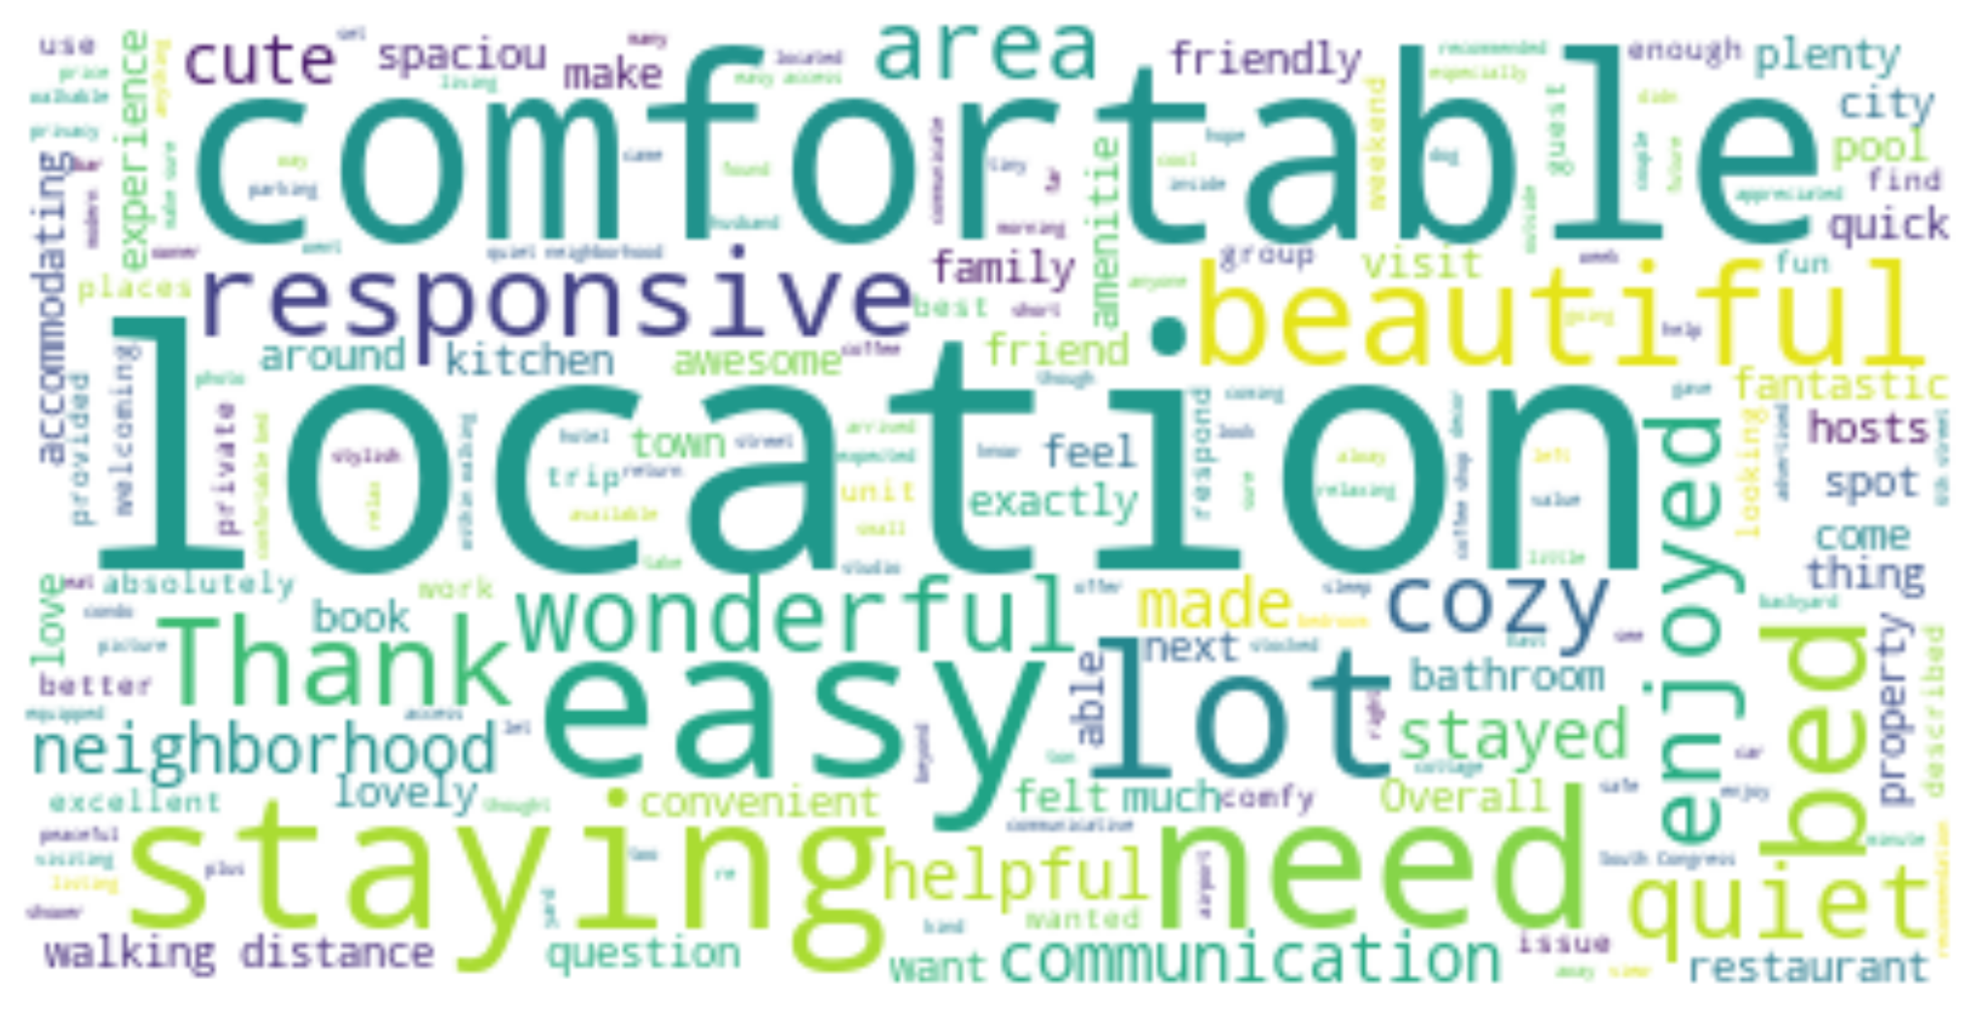
Words Appeared In Guests Reviews (Size per amount)

Slide 22
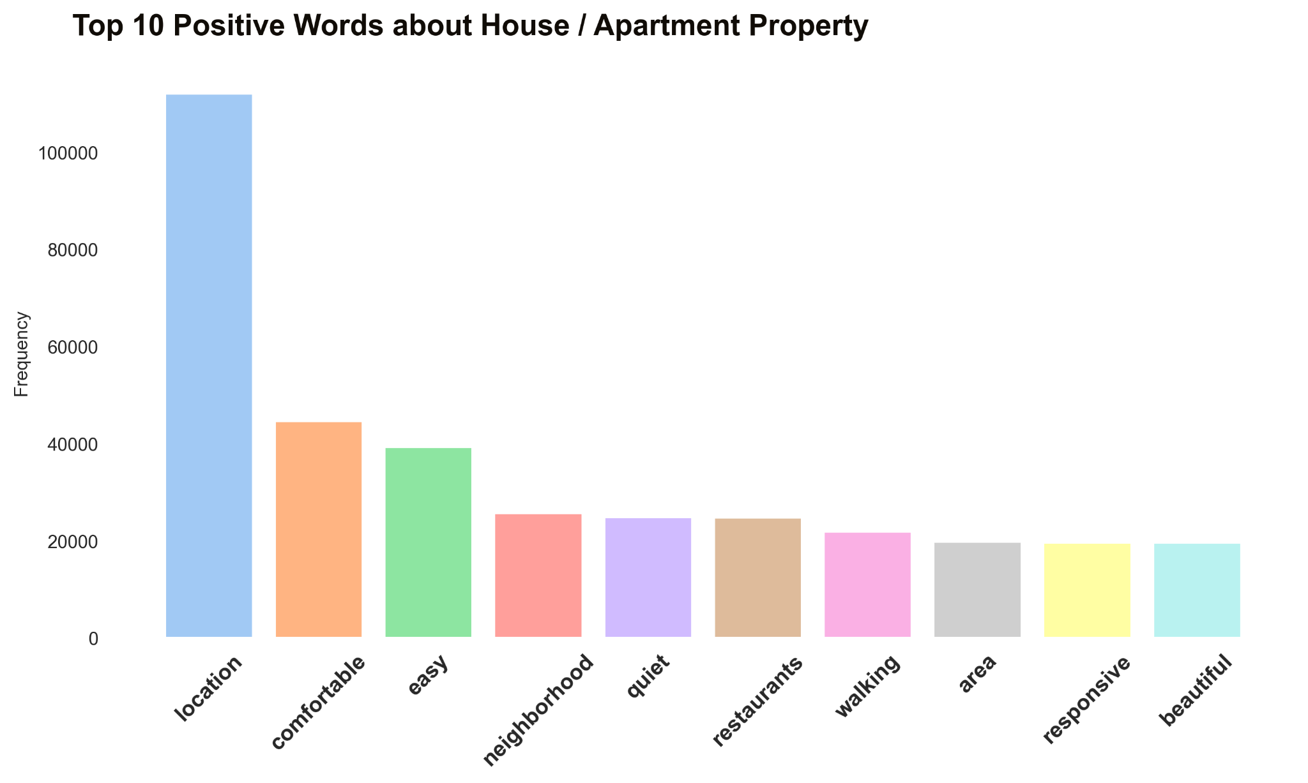

Slide 23
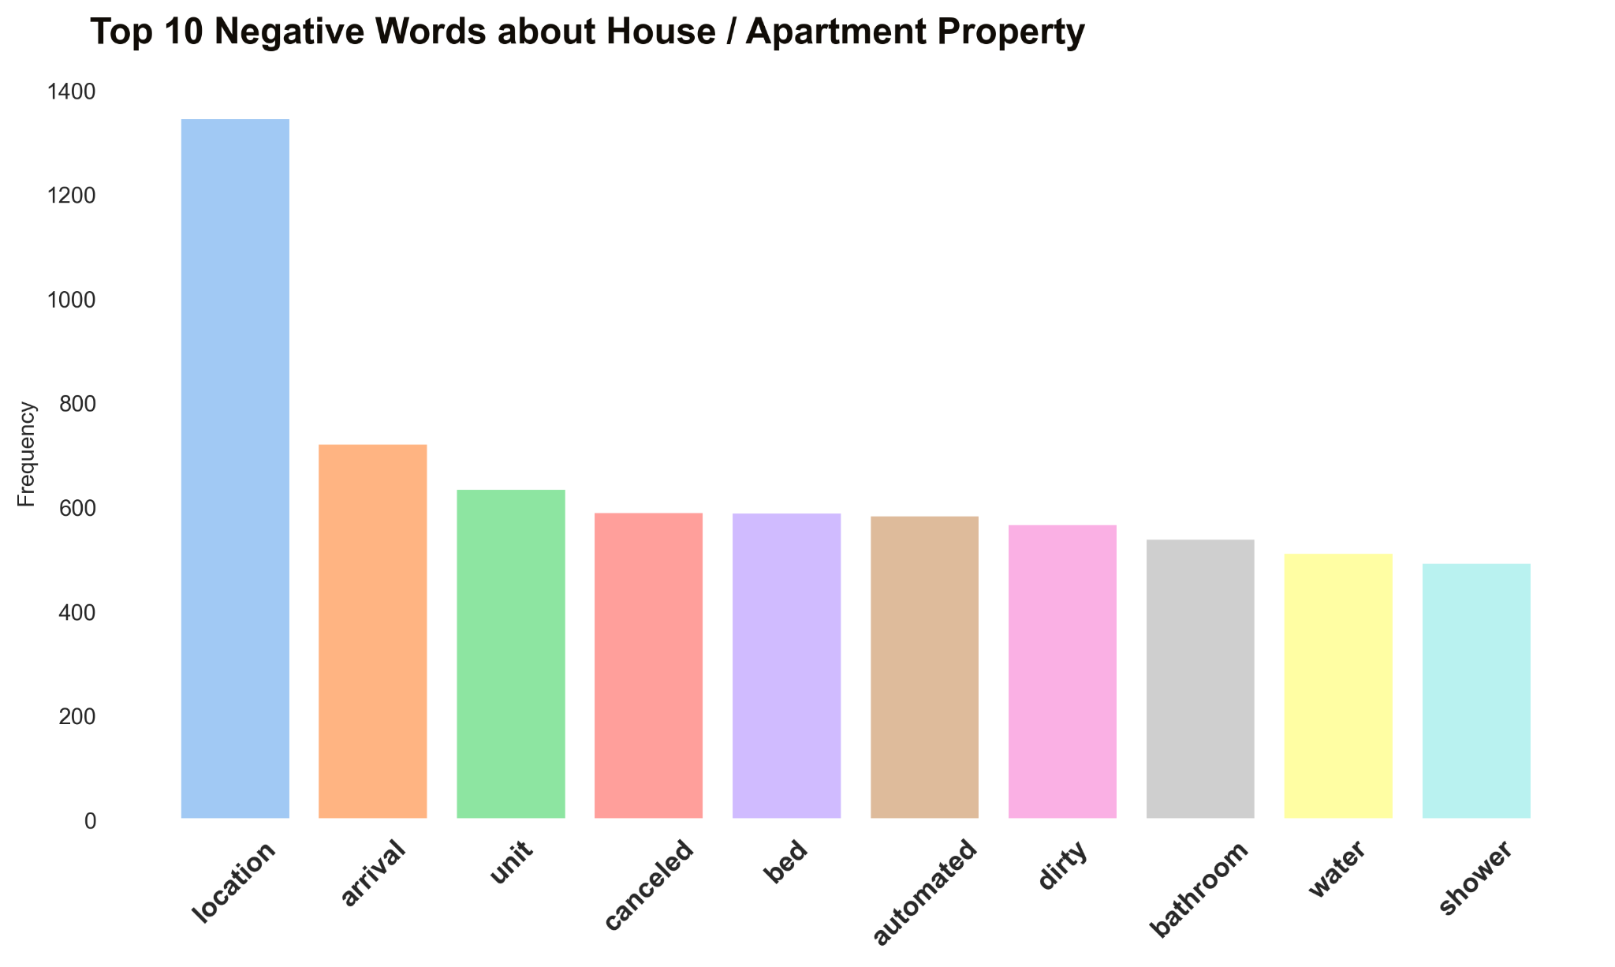

Slide 24
High Demand Season: Feb-Mar / Sept-Oct
Pricing Trends:
South Central & East Austin listings have the highest nightly rates
Seasonal patterns also influence pricing, with rates increment during peak season
Guest Preferences:
Predominantly entire homes / apartment are booked
Most frequently cited reasons for travel - vacations & leisure
Key Findings

Slide 25
High Amenities prevalent:
Kitchen, Smoke alarm, Essentials, WI-FI & Hairdryer
Free parking lot stood out as a unique offering and often commanded higher price per night
Review Sentiments:
Guest reviews indicated that location, comfortable, and neighborhood were critical factors influencing overall guest satisfaction
Listings with consistently positive reviews tended to perform well
Key Findings - Amenities & Reviews

Slide 26
Pricing Strategy:
Dynamic pricing strategies to maximize revenue during peak demand periods while remaining competitive during low-season
Amenity Enhancements:
Important to invest in standout amenities that align with guest preferences to increase listing desirability
Reviews Main takeouts:
Location with walking distance from Downtown & within Quiet neighbourhood
Have nearby different sort of restaurants
Conclusions & Recommendations

Slide 27
Overall - It is not ideal period to invest in Austin AirBnB Market
AirBnB Market in Austin grow slowly post the pandemic
Most interest in AirBnB is House / Apartment properties which usually more costly
If we look at the bigger US market, it worth deeper analysis:
There is a big grow & investments in High-Tech and Industries in Austin
Long listing periods (3-6 Months)
Tax law beneficial & incentive can significantly enhance the property's profitability and long-term value
Conclusions & Recommendations
Notes:
Growing investments in high-tech & increase of start-ups
Become one of the hottest relocation hotspots for tech talent during the pandemic, and favorite by San Francisco techies
Tesla founder Elon Musk has a Cybertruck factory under construction outside the city, and his Boring Company recently bought an industrial site nearby

Slide 28



Slide 29


Slide 30
Airbnb's Global Success & Austin Specific
Airbnb has demonstrated consistent revenue growth YoY, Expand for new markets & services, Expanded its business beyond just accommodations
Variety of tourism types (Students, Friends, Families, Business)
Investing in Airbnb properties in Austin means tapping into a city that boasts a thriving job market and a high quality of life
Tourism spread across the year and growth YoY
Gentrification, rising housing costs, and a homelessness crisis are just some of the issues plaguing the Austin
Growing business visitors & Short terms business trips which require variety of properties
The Airbnb market in Austin is on a remarkable upward trajectory, with over than ~10.1K listings with reviews in 2023 (June) & growing
What It's Like in the Growing Tech Hub of Austin, Texas
Notes:
For users - Airbnb growing as it alternative accommodation per market demand, operates in numerous countries & cities worldwide, platform is user-friendly, Enable diverse offering, Review & rating system builds trust among users, Airbnb has worked to adapt to local regulations and address concerns from cities and communities. This adaptability has allowed it to navigate regulatory challenges in various markets

Slide 31
Additional insights?
Notes:
SuperHost

Slide 32
Superhost Status:
Aspiring hosts should aim to meet the criteria for Superhost status, as it positively impacts number of bookings
Notes:
Consider if we have the Supor Host Analysis

